Slide 1
Final Project Presentation
The Flying Wombats

Slide 2


System Design
Purpose: The purpose of this project is to create a turn-based combat game that can be both engaging to play and play itself.
System Overview: The game has been developed in Unity using C# and using Google’s Firebase.
System Architecture: Desktop based software requiring a mouse, using the Unity engine, C#, SQL, and Firebase
Database: The database stores player log-ins and game stats.
System Security: The main level of security is the log-in system and any security already integrated into unity and firebase

Slide 3
Roles and Responsibilities
Samuel Maynard: Project Manager, art direction, audio assistant
Shane Callaway: Assist with UI design and function, basic level combat, player and enemy stats, leveling, and balancing of combat
Thomas Mattei: User Interface/Menu Transitions, Assist with Online PvP
Alton Stillwell: Online Matchmaking (PvP) Programming, Mirror Integration, Audio
Kaitlyn Staats: Database design and integrating the database into unity.
Evan Colyer: AI programming, both for player characters and enemy non-player characters.

Slide 4
Audio
Music is attached to Unity game objects in their respective game scenes
Sound effects like melee hits are routed through the audio manager script, minimizing the amount of code that needs to be added to PlayerCharacter, EnemyCharacter, and the CombatControl scripts

Slide 5
Combat AI
Combat AI is handled by a function in both the PlayerCharacter and EnemyCharacter classes called TakeTurn()
Every round the function checks for the mana level of the combatant and uses an ability based on how much mana the combatant has – for instance, if the player has 10 mana it will use their Ultimate ability, if the player has 6 then it will use the fire ability, and if less than 6 it will just attack
The functions are currently barebones but can be expanded easily based on future additions to the game

Slide 6
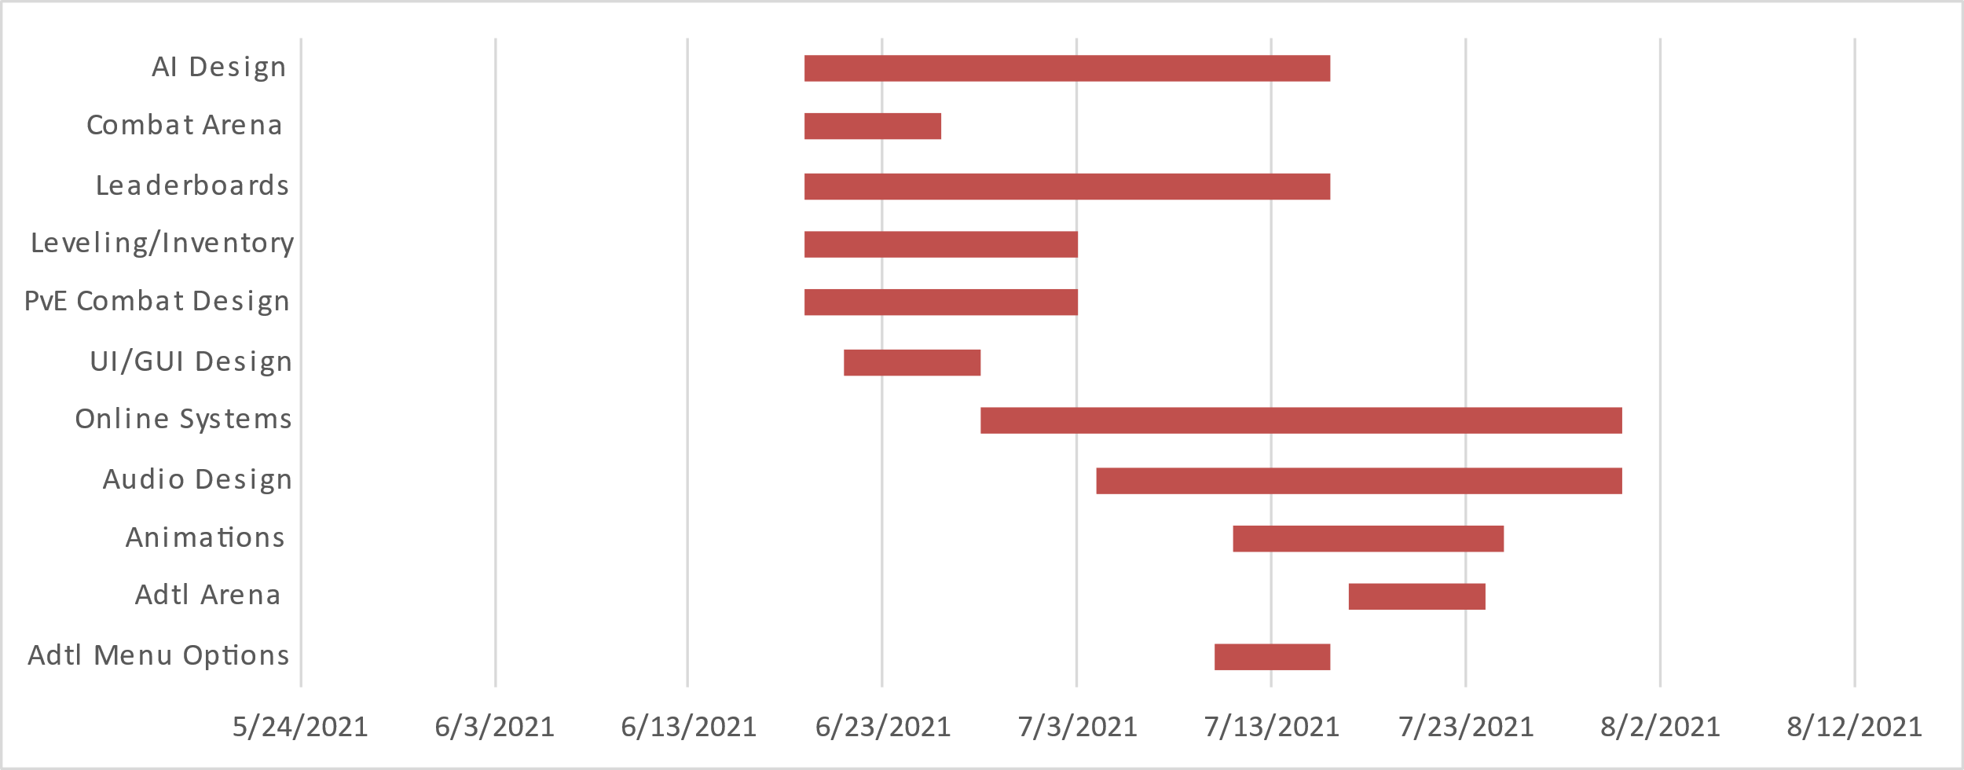
Gant Chart
Task Name | Start | End | Duration (days)
Adtl Menu Options | 7/10/2021 | 7/16/2021 | 6
Adtl Arena | 7/17/2021 | 7/24/2021 | 7
Animations | 7/11/2021 | 7/25/2021 | 14
Audio Design | 7/4/2021 | 7/31/2021 | 27
Online Systems | 6/28/2021 | 7/31/2021 | 33
UI/GUI Design | 6/21/2021 | 6/28/2021 | 7
PvE Combat Design | 6/19/2021 | 7/3/2021 | 14
Leveling/Inventory | 6/19/2021 | 7/3/2021 | 14
Leaderboards | 6/19/2021 | 7/16/2021 | 27
Combat Arena | 6/19/2021 | 6/26/2021 | 7
AI Design | 6/19/2021 | 7/16/2021 | 27

Slide 7
Change Log
Change Log
Project: Turn-Based Combat Game |  |  |  |  |  | Date: 7/31/21
Change No. | Change Type | Description of Change | Requestor | Date Submitted | Date Approved | Status | Comments
1 | Design/Scope | The removal of an additional combat arena | Sam M. | 7/3/21 | 7/3/21 | Approved | No additional combat arenas were added to the game due to time constraints
2 | Design/Scope | Change from using MySQL for the database to Google Firebase | Kaitlyn S. | 7/5/21 | 7/16/21 | Approved | Change made due to cost and time constraints, as well as ease of use for the developers and end user
3 | Design/Scope | Open world environment and related gameplay elements scrapped | Sam M. | 6/7/21 | 6/7/21 | Approved | Open world concept scrapped due to concerns of exceeding the scope of the game design
4 | Design/Scope | Scrapping character customization/multiple characters per player | Kaitlyn S. and Alton S. | 7/10/21 | 7/10/21 | Approved | Scrapped due to technical difficulties for KS and AS developing backend systems
5 | Design/Scope | Removing the requirement for a Google account for player signup | Kaitlyn S | 7/3/21 | 7/10/21 | Approved | The requirement of a Google account to create an account in game scrapped due to technical limitations
6 | Design/Scope | Scrapped the addition of an “endless” game mode | Shane C. | 6/21/21 | 6/21/21 | Approved | Scrapped additional mode due to worries of exceeding development scope

Slide 8
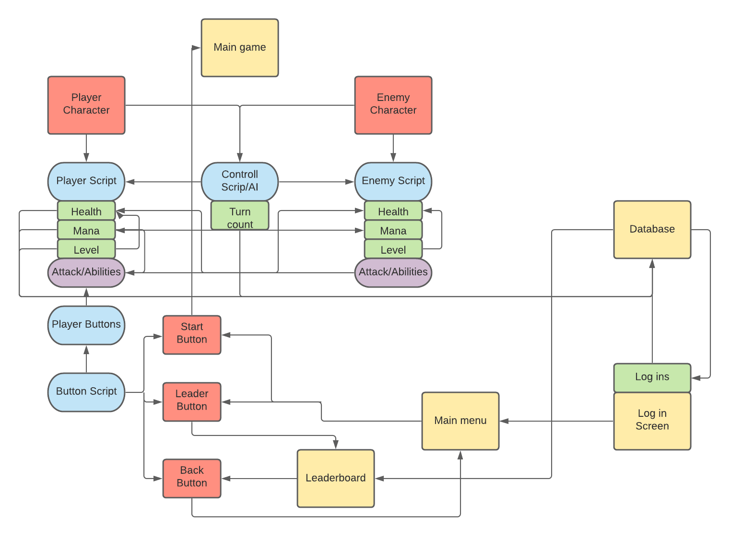
Relationship Charts

Slide 9
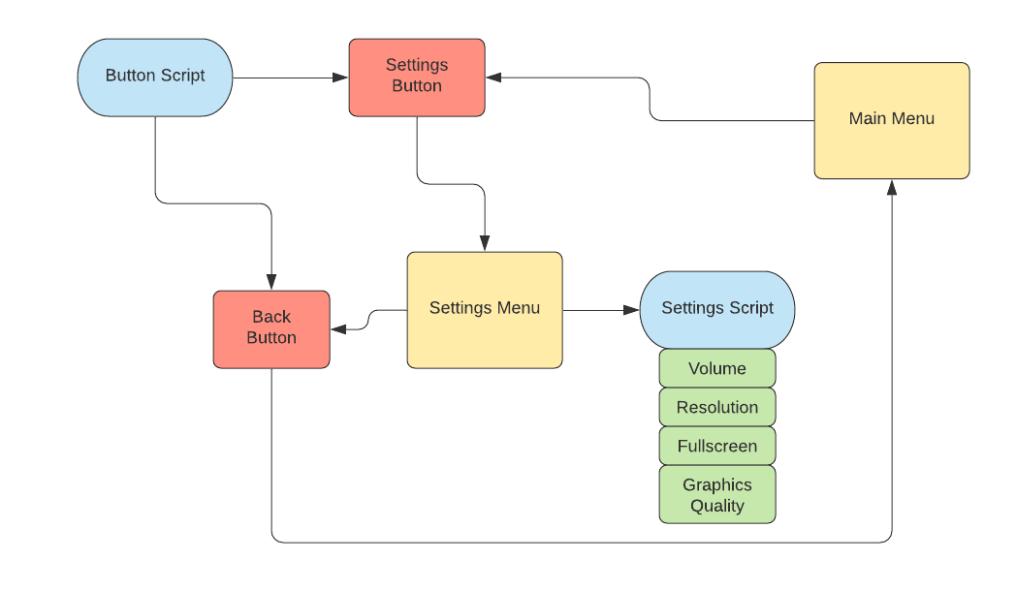
Relationship Charts Cont..

Slide 10
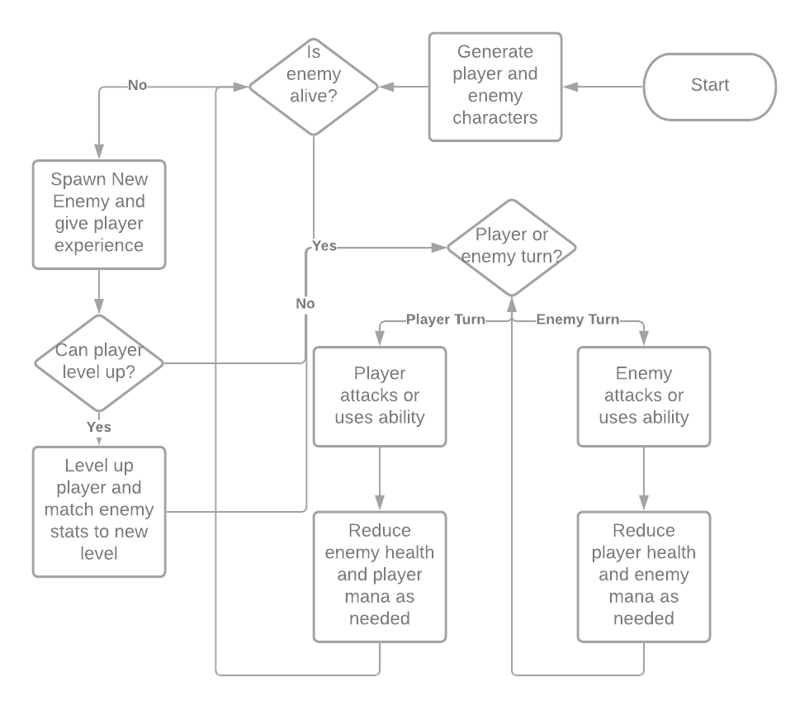
Combat Dataflow Chart

